Slide 1

Introduction to Data Science (0602241) Submitted To: Dr. Rasha Al-bashaireh
SPRING Semester-
2023/2024
final Paper Presentation
College of Information Technology and Communication

Slide 2
Big Data in military by using IoT
GROUP NO#: 1 GROUP MEMBER’S NAMES:محمد-حسن-احمد-مؤمن

Slide 3
INTRODUCTION
1- Big data in Military: The term big data in the military context refers to the vast and complex datasets generated by various military sources.
2-why Big data in military important?
Enhanced Decision-Making: Big data provides military leaders with real-time insights and predictive analysis, which are crucial for making informed strategic decisions

Slide 4
INTRODUCTION
3-background about big data in military:
-Data Management and Analysis: The military collects zettabytes of data from IoT devices, which requires sophisticated software and hardware to process and analyze.
What is the relationship between the Internet of Things and big data
interconnected on the one hand:
Data Generation: IoT devices are equipped with sensors and electronics that collect data from their environment. [1].

Slide 5
Methodology on paper_1
How does the Internet of Things work ? An optimized IoT system works by collecting and exchanging data in real time It consists of three several elements:[4]
Smart Devices: These are devices such as (smart military suit , internet connected smart helmets) and training equipment equipped with computing capabilities. It collects data from its surroundings, user inputs or usage patterns and transmits the data over the Internet to and from its associated IoT application .

Slide 6
Methodology on paper1
2-Internet of Things application : An IoT application is a set of services and software that integrates data received from different IoT devices.
It exploits machine learning or artificial intelligence technology to analyze this data and make informed decisions.
These decisions are feedback to the IoT device,
and the IoT device then responds intelligently to the inputs.
3-Graphical user interface : An (IoT) device or group of devices can be controlled through a graphical user interface.
Common examples include mobile applications or a website that can be used to register and control smart devices.

Slide 7
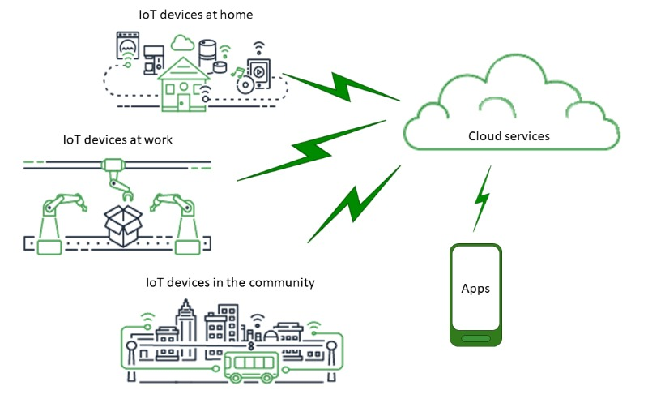
Methodology on paper1

Slide 8
Methodology on paper2
what techniques are used in military?
Drons : In the military context, drone systems work in conjunction with big data to enhance operational capabilities and decision-making
They work through:
Data Collection: Military drones are equipped with various sensors that collect a wide range of data, including visual, thermal, and radar signals. This data is crucial for intelligence, monitoring[3].

Slide 9
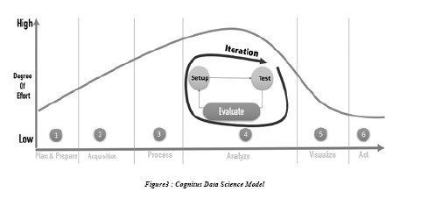
Methodology on paper3
How to analyze data for the military field?
1-Analysis and preparation
2-Data is used in two ways: real-time or in batches. In real-time mode, information flows from sources such as sensors, probes,
3-Data cleaning,
4-The analysis stage is the most accurate stage, and since this process is interactive, the evaluation procedure is repeated as new data becomes available
5-Show the result in an interactive way
6-Decision making process[4]

Slide 10
Results and discussion on 3 paper
IoT devices provide the real-time data that feeds into big data, and big data analytics processes this information to improve decision-making and operational efficiency across various sectors, including the military.

Slide 11
References on 3 paper
[1]:How is IoT Related to Big Data Analytics? | PTC
[2]:Big Data at War: Special Operations Forces, Project Maven, and Twenty-First-Century Warfare - Modern War Institute (westpoint.edu)
[3]:https://aws.amazon.com/ar/what-is/iot/
[4]: https://www.lebarmy.gov.lb/ar/content/%D8%A7%D9%84%D8%A8%D9%8A%D8%A7%D9%86%D8%A7%D8%AA-%D8%A7%D9%84%D8%B6%D8%AE%D9%85%D8%A9-%D9%81%D9%8A-%D8%A7%D9%84%D8%A7%D8%B3%D8%AA%D8%AE%D8%A8%D8%A7%D8%B1%D8%A7%D8%AA-%D8%A7%D9%84%D8%B9%D8%B3%D9%83%D8%B1%D9%8A%D8%A9

Slide 12
Questions ?

